Slide 1

DCJS
Office of Probation and Correctional Alternatives
Ignition Interlock:
“Leandra’s Law” in New York State
STOP-DWI Association
Mid Year Meeting
May 28, 2014
Shaina D. Kern
Community Corrections Representative II
NYS Division of Criminal Justice Services
Office of Probation and Correctional Alternatives
OFFICE OF PROBATION
AND CORRECTIONAL ALTERNATIVES

Slide 2
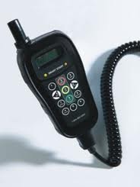

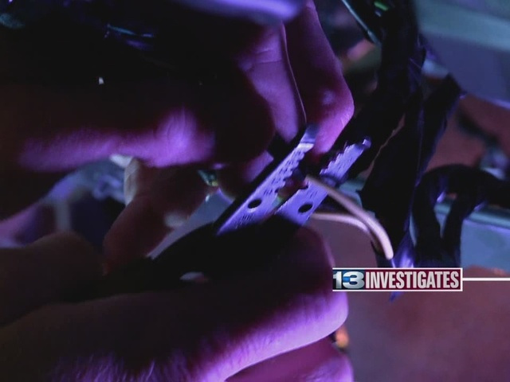
Ignition Interlock Devices
Alcohol breath-testing device installed in a motor vehicle that requires the driver to provide a breath sample below a pre-determined alcohol set point in order to start the engine. If the breath sample is at or above the pre-determined BrAC, the IID prevents the vehicle from starting.
Devices w/Real Time Data reporting contemporaneously transmit data of particular events to monitors as the event occurs or as soon as cellular reception permits.
Properly installed and monitored interlock systems are extremely difficult to circumvent.

Slide 3

“Leandra’s Law” in NYS
Chapter 496 of the Laws of 2009 - signed into law
November 18, 2009
  First Effective Date--December 18, 2009—VTL §1192-2a (b)
  New Class E Felony Offense-Enhanced Penalties for Persons who Operate a Motor Vehicle while Intoxicated with a Child passenger under 16 years of age, with penalty of up to 4 years in state prison.
Notes:
Chapter 496 of the Laws of 2009, “Leandra’s Law”, accomplished two goals: first to increase the penalty for driving drunk with children in the vehicle, and the second to increase the imposition of the ignition interlock device.

Slide 4
“Leandra’s Law” in NYS
  Second Effective Date August 15, 2010– VTL §1192 (2), (2-a), or (3)
  Requires that persons convicted of having committed VTL Section 1192 misdemeanor or felony DWI crimes, on or after the date of enactment, (November 18, 2009) and sentenced on or after August 15, 2010; shall be sentenced to a period of probation or conditional discharge, in addition to any sentence of imprisonment or payment of any fine or penalty imposed, and that they be ordered to install an Ignition Interlock Device (IID) in any motor vehicle they “own or operate.”
  The term of probation or conditional discharge shall run consecutive to any term of imprisonment.
  The IID condition appears on the NYS Driver’s License and the Driver’s License File.

Slide 5
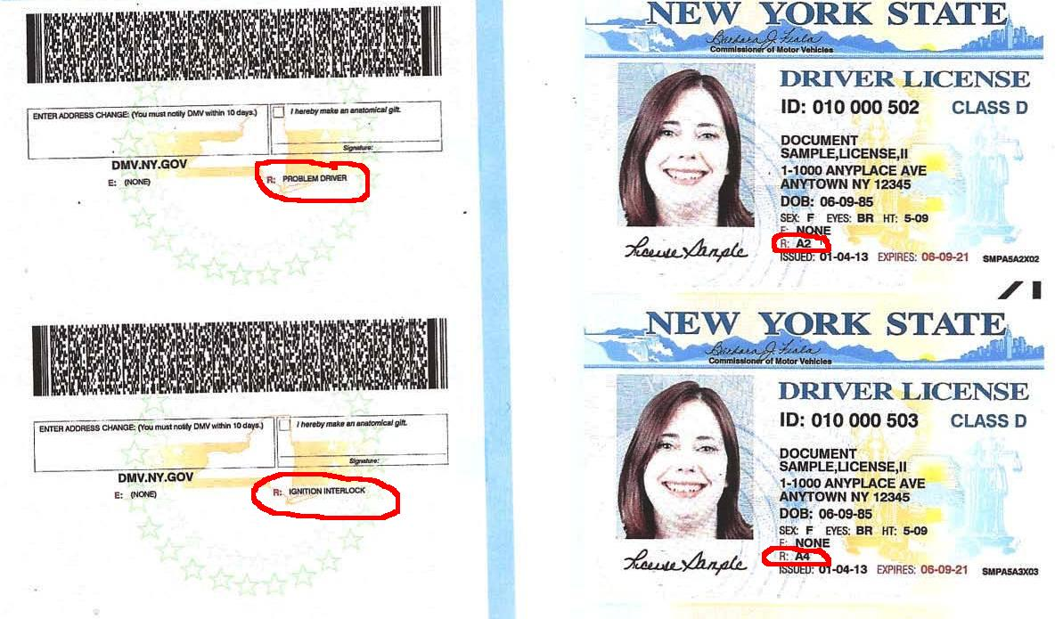
A2 Vs. A4 License Restrictions

Slide 6
Chapter 169 of the Laws of 2013
On July 26, 2013, Governor Cuomo signed S5859/A02885-A into Law to strengthen Leandra’s Law. This amended Chapter 496 of the Laws of 2009 and took effect Friday, November 1, 2013. The new law applies to those violations committed on or after November 1, 2013 and accomplishes the following:
Extends the period of interlock restriction to a minimum of 12 months (from 6 months). Installation requirement shall terminate upon submission of proof from the offender that they had installed and maintained the device for at least six (6) months unless the court ordered a longer duration of installation.
Authorizes the imposition of IIDs to be installed prior to sentencing as a preventive measure. The period of IID restriction will commence from the earlier of the date of sentencing or the date an IID was installed in advance of sentencing.

Slide 7
Chapter 169 of the Laws of 2013
Those defendants who claim he/she is not the owner of any motor vehicle and that he/she will not operate any motor vehicle during the period of interlock restriction must assert such under oath and on the court record.
New language will potentially subject an offender to additional charges if he/she is found to have intentionally made a false statement to a court.
“Owner” shall have the same meaning as provided in Vehicle and Traffic Law §128.

Slide 8
Chapter 169 of the Laws of 2013
Ensures that youth adjudicated as Youthful Offenders of DWI will be subject to Leandra’s Law provisions, including the ignition interlock requirement.
Expands upon the Class E Felony, Aggravated Unlicensed Operation 1st degree to capture operators who were given the benefit of a conditional license after a DWI and/or alcohol related offense and then drive impaired again.

Slide 9
New York State Ignition Interlock Regulation
Title 9 NYCRR, Part 358
DCJS promulgated strict state regulations governing the timely installation and monitoring of compliance by persons ordered to install and maintain Ignition Interlock Devices.
Part 358 outlines regulations as they relate to the responsibilities of operators, manufacturers, installers, and monitors.
Judges play an important role in the enforcement of court-ordered probation and monitoring conditions.

Slide 10
9 NYCRR Part 358 and
Statutory “Unaffordability” Provisions of Law
“Unaffordability” distinguished from Indigence
Financial Disclosure Report (DPCA-500IID-FDR)
available (English/Spanish) at http: www.criminaljustice.ny.gov/opca/ignition.htm
  Operator /Applicant required to complete/submit 3 copies to court
  FDR Form captures offender’s income, assets and expenses, including monthly service for cell phone, cable/satellite television
  Progression of Cost Considerations by Judiciary : Affordability>>>> Payment Plan (partial payment)>>>> Waiver Considerations (Waivers are not free)
  IID Manufacturer agreements provide a maximum statewide rate of “unaffordability” of 10% before renegotiation is considered.

Slide 11
Interlocks are Effective & Economical
The cost of a cup of coffee: $2/day
One round trip bus fare: $3/day
The cost of a gallon of milk: $3.50/day
The cost of a pack of cigarettes: $10/day
The cost of an ignition interlock: $3/day
The cost of saving a life: PRICELESS

Slide 12
NYS Ignition Interlock Program
Monitoring & Offender Accountability –Touchstone of Effective Ignition Interlock Program:
    Localities (Probation and Monitors) Perform Monitoring and Supervision
    NYS Governor’s Traffic Safety Committee (GTSC) continues to provide nearly $3 million in NHTSA funds to be distributed to localities based on number of convictions where an IID is ordered
    Current Grant term: October 1, 2013-September 30, 2014
    Includes Monitoring of operators who do not install IID’s
Notes:
There are many things to consider in developing an effective interlock program. Maintaining accountability is paramount. We also must be mindful of the impact this accountability has on the localities tasked with monitoring…

Slide 13
9 NYCRR Part 358
Four Qualified Ignition Interlock Manufacturers to serve potential population of 26,000 DWI offenders:
  NYS divided into four (4) regions (consistent with COPA regions) to ensure that service is available in all localities.
  Manufacturers must maintain network of installation service providers within 50-miles of each operator.
  State Regulations provide that Operators may shop manufacturer (Model) but probation and monitoring agencies will determine the Class of ignition interlock device and probation will determine Class and Features.
Notes:
COPA-Council of Probation Administrators

Slide 14
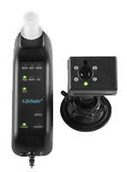
NY Ignition Interlock Device Classification System
For installations on or after November 1, 2013 a camera is a requirement of ALL Ignition Interlock Devices.
photo of the operator will be taken every time he/she is prompted to take a test. Increases offender accountability and is of beneficial use for evidentiary purposes in cases of failed tests.

Slide 15
New NYS IID Classification System
For installations on or after November 1, 2013:
Class I: This device contains the following features: Meets all New York State DOH (Part 59), NHTSA Regulations and Standards, utilizes fuel cell technology, capabilities for storage of data, programmable re-test sequences, data download, anti-tampering and anti-circumvention features, camera-photographic positive identification capability, photo of the operator will be taken every time operator is prompted to take a test, infra-red or other low light camera capability for night use, breath sample validity features, 24/7 access to operator data by monitors, and voice or visual instruction.
Class II: This device has all the features of Class I and contains the following additional features: Global Positioning System (GPS) location of vehicle and Real Time Data (RTD) reporting.
Class III: This device has all the features of Class I and II and includes capacity for Emergency Notification to Law Enforcement- Emergency Response Program for interception of a targeted vehicle during a Rolling Re-Test failure.

Slide 16
9 NYCRR Part 358
DCJS/OPCA Regulation requirements for installation of IID’s and notifications:
Monitor shall receive notification from the Court pursuant to its county plan for IID condition/installation within 5 business days
Operators required to have IID installed w/in 10 business days of Court Order
Operator shall provide proof of installation within 3 business days to Court, County Probation Department or designated Monitor
Operator shall submit to service visits within 30 calendar days. For detachable handheld units, submit to 30-day visits, followed by 60-day visits

Slide 17
Non-Compliance with IIDs
Probation Departments and CD Monitors must notify the Court and District Attorney within three business days of the following:
  Operator failure to install IID on the vehicle(s) he/she owns or operates
  Operator has not complied with service visit requirements
  Report of alleged or attempted tampering or circumvention of IID
  Report of failed or missed start-up retest, or
  Report of failed or missed rolling retest, or
  Report of vehicle entering lock-out mode
  Any report of a failed test or re-test where BAC is .05% or higher

Slide 18
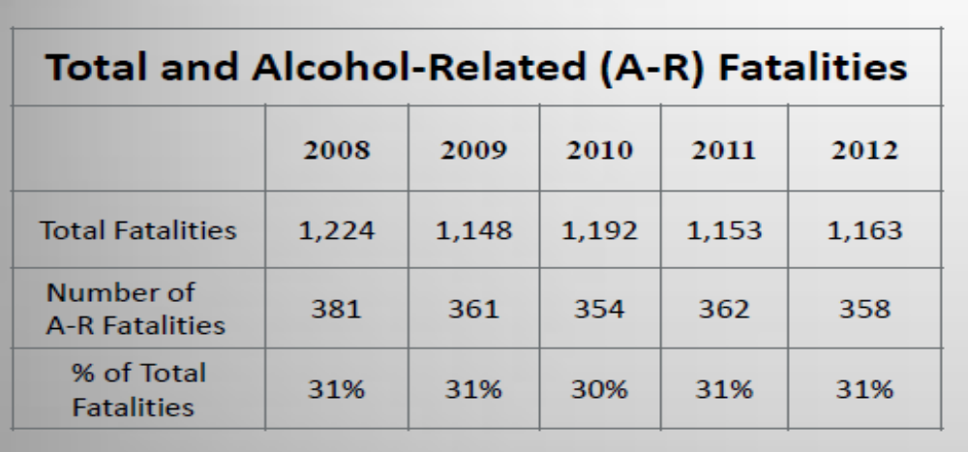
Goal: Reduce Alcohol Related Fatalities
Source: Institute of Traffic Safety Management Research

Slide 19
Reports: IID Negative Events/Failed Tests by County & by IID Manufacturer
OPCA works with NY’s Qualified IID Manufacturers & DCJS’ Office of Justice Research and Performance to produce two informative reports which relate directly to offender accountability.
The data reflects the following events:
  Missed Service Visits
  Failed/Missed Start-up Re-tests
  Failed Start-up Re-tests with BrAC Range ≥ .08
  Failed/Missed Rolling Re-tests
  Failed Rolling Re-tests with BrAC Range ≥.08
  Lock-outs Initiated
  Vehicles Disabled and Attempted Circumvention or Tampering.

Slide 20
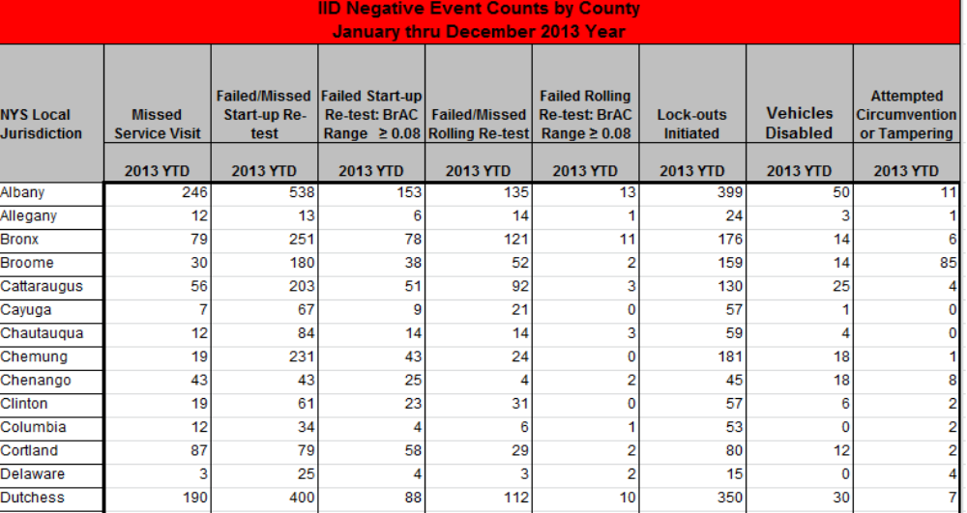
IID Negative Events/Failed Tests Report by County

Slide 21
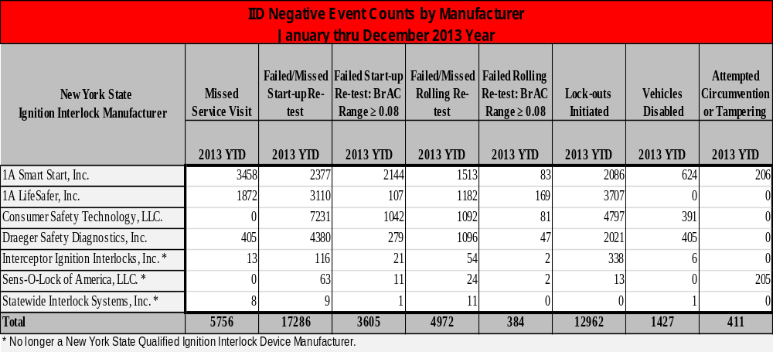
IID Negative Events/Failed Tests Report by Manufacturer

Slide 22
Metrics--DWI Arrests in New York State
DWI Arrests VTL Section 1192
Year | Felonies | Misdemeanors | Total
2010 | 7,050 | 47,474 | 54,524
2011 | 6,429 | 44,042 | 50,471
2012 | 6,199 | 42,629 | 48,828
2013 | 6,014 | 42,218 | 48,232

Slide 23
Leandra’s Law Dispositions
December 18, 2009-April 22, 2014
Class E Felony Arrests (VTL 1192 (2-a)(b))
Aggravated DWI with a Child under 16 years of age in the motor vehicle
Arrests : 3,704
Dispositions: 2,834
Total Sentences: 2,710

Slide 24
Leandra’s Law Sentences
Aggravated DWI with Child Cases
December 18, 2009-April 22, 2014
Sentences:
Prison | 111 (4.1%)
Local Jail | 213 (7.9%)
Time Served | 20 (0.7%)
Jail & Probation | 543 (20%)
Probation | 1234 (45.5%)
Fine | 509 (18.8%)
Conditional Discharge | 76 (2.8%)
Unconditional Discharge | 4 (0.2%)
TOTAL SENTENCES | 2,710 (100%)

Slide 25
Total Program Report of
IID Orders and/or Installations in NYS:
August 15, 2010 thru March 31, 2014
  63,596 ignition interlock orders were issued
  17,511 interlocks installed (rate of 27.5%)
  IID Fee Payments
  89.8% (15,739) of defendants were ordered to pay the full cost of the interlock
  3.7% (640) of defendants were ordered to make partial payment
  6.5% (1,132) of defendants were granted waivers

Slide 26
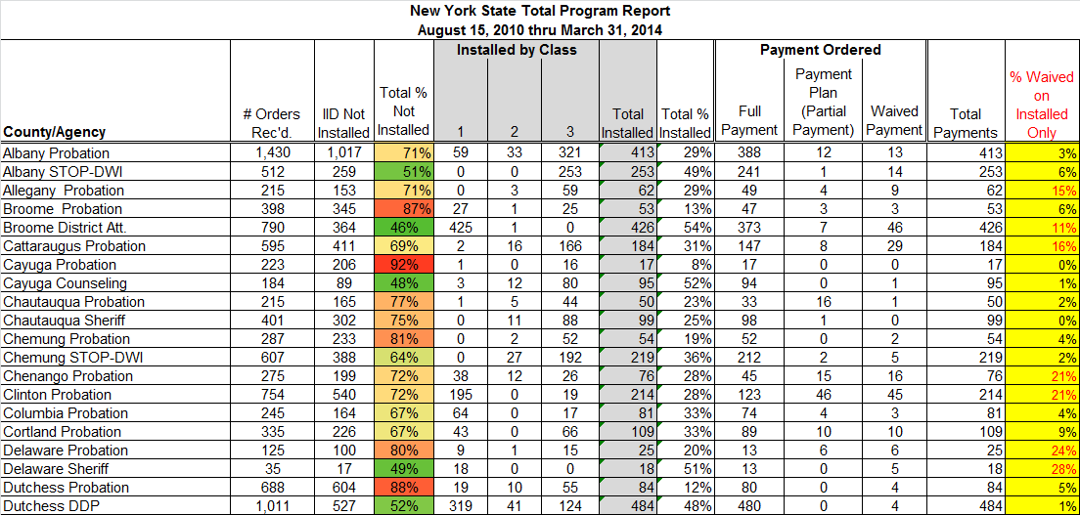
Total Program Report
August 15, 2010 thru March 31, 2014

Slide 27
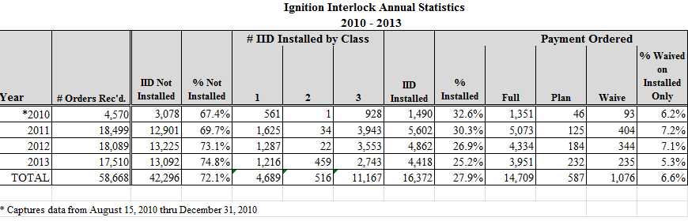

Slide 28
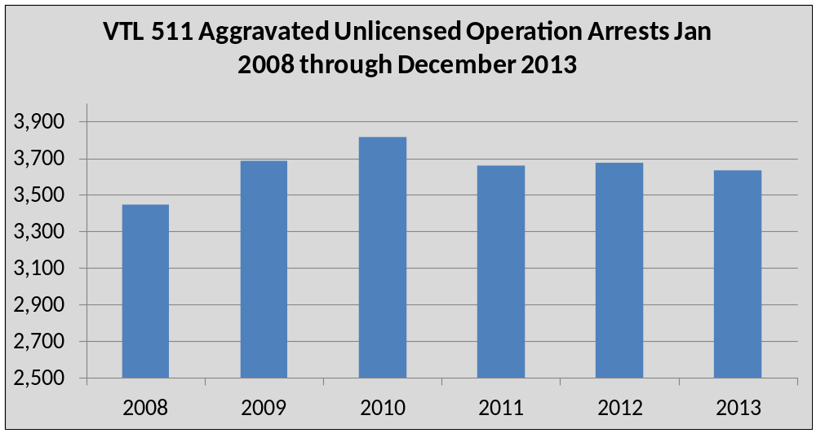
Unlicensed Operators Will Continue To Drive………

Slide 29
IID County Contract Renewals:
New Tasks & Performance Measures
Task:
All operators court ordered to have an IID installed pursuant to “Leandra’s Law” and/or its amendments shall be registered in the New York State DMV License Event Notification System (LENS), or comparable system for the duration of the period of Probation, Conditional Discharge, or the pre-sentence Ignition Interlock order, where the probation department or other monitoring agency is permitted access to LENS.
Performance Measure:
The number of operators court ordered to have an IID installed pursuant to such aforementioned laws who are registered in NYS’ DMV LENS, or comparable system by the applicable monitor each quarter.

Slide 30
IID County Contract Renewals:
New Tasks & Performance Measures
Task:
For all operators ordered to install an IID pursuant to Leandra’s Law, but who have not had such devices installed because of operator’s claim that they do not own or operate any vehicle(s), the applicable monitor will make inquiries to NYS’ DMV at least once per quarter to ensure that no vehicles are registered or titled to such person.
Performance Measure:
The number of operators ordered to install an IID pursuant to such aforementioned laws who have not had such devices installed, regarding whom the applicable monitor has made inquiries to the NYS DMV to ensure that no vehicles are registered or titled to such person during each quarter.

Slide 31
IID County Contract Renewals:
New Tasks & Performance Measures
Task:
For vehicles found registered or titled to those operators ordered to install an IID pursuant to Leandra’s Law, but who have not had such device installed because of operator’s claim that they do not own or operate any vehicle(s), the applicable monitor will notify the court and district attorney forthwith and consider instituting violation actions where appropriate.
Performance Measure:
The number of notifications made by the applicable monitor to courts and district attorneys regarding those operators with vehicles found registered or titled to them but who have not had an IID installed because of the operator’s claim that they do not own or operate any vehicle(s).

Slide 32
DMV Data Access Quick Reference
License Event Notification System (LENS)- Will notify monitors of any tickets or other changes to a driver’s license. Apply for a new account at: https://transact.dmv.ny.gov/lenxforms/prereg_cust/preg_main.cfm
Integrated Justice Portal (IJP)-Allows monitors to do an immediate search for registration, license and title. Special searches such as registrations by address or business can be run in Special Computer Applications. Monitors must request access from their Terminal Agency Coordinator (TAC) and then the site can be reached via: https://www.ejusticeny.ny.gov/

Slide 33
DMV Data Access Quick Reference
DMV Dial-In is a legacy DMV program used to access information on titles, registrations and driving records. Dial-in is not assigned to new monitors, but older monitors may still have access. Dial-In is being replaced by the COMPASS system. Dial-In is still offered to private (non-law enforcement) agencies. Access is granted via a MV-15D form.
DMV COMPASS is the new program to replace Dial-In. It is slightly more user friendly and will be given to new monitors completing an MV-15D requesting access to it. Unlike Dial-In, COMPASS allows the use of * as a “wildcard” if a monitor is unsure how to spell the name of the person they are searching. Ex: Smith, Jo* with search for John, Jonathan and Jonathon.

Slide 34
Graduated Responses
Graduated responses are utilized to hold offenders accountable and change offender behavior.
Sanctions to address Non-Compliance
  Increased reporting days and frequency of alcohol/drug testing
  Increased ignition interlock term
  Use of monitoring technology including alcohol monitoring devices, and GPS
  Curfew or home confinement
  Administrative Hearings
  Recommendation for Judicial Reprimand
  Filing of Violation (CD revoked and offender resentenced to probation)
Positive Incentives or Rewards for Compliance
  Verbal and Written Recognition of Compliance/Success in Treatment, Supervision
  Decreased reporting days
  Approval of travel permits
  Approval to apply for relicensure
  Consideration for early discharge for satisfying all conditions

Slide 35
2014 Interlock Updates
DCJS revised some Ignition Interlock forms at the request of the judicial and monitoring communities in 2012 and is currently doing so again due to the recent revisions of Leandra’s Law.
Working with DCJS’ Office of Legal Services, NY Office of Court Administration, NYS DMV, and City, Town and Village Justice Resource Center to refine forms for both Courts and Monitors.
A Judicial Liaison was hired to assist with Interlock/Leandra’s Law court related issues.
Counties have been required to reconvene their interlock work groups and submit an updated Ignition Interlock Program Plan to DCJS by June 17, 2014.
Manufacturers have just completed their 2014 Installation/Service Provider Audits/Reviews to ensure compliance with Title 9 NYCRR, Part 358.
DCJS’ Fifth Annual IID Manufacturer’s Conference will be held at the Alfred E. Smith Building in Albany June 26, 2014.

Slide 36
Ignition Interlock Program
Contact information for all IID/Leandra’s Law related inquiries:
Shaina Devine Kern
Shaina.Kern@dcjs.ny.gov

