Slide 1

MEDICAID HEALTH HOMES AND CRIMINAL JUSTICE
NYS DCJS/OMH Justice & Mental Health Collaboration Program
June 22, 2015

Slide 2
JMHCP--Intersection of Medicaid HH and Criminal Justice
Addressing physical and behavioral health needs and ensuring justice –involved individuals have access to healthcare, promotes pro-social behavior and recovery
In turn, this supports the goals of the Medicaid Redesign for better health and lower costs, and criminal justice goals for greater public safety and reduced recidivism
These presentations are intended to provide examples and resources for Counties, Health Homes and Criminal Justice Entities as they work together to support recovery and meet their goals

Slide 3
Webinar Audience
DCJS JMHCP Pilot Counties—Probation Directors, Mental Hygiene Commissioners and Jail Administrators
Invitation is extended to:
All Probation Departments, County Mental Hygiene Directors, Jail Administrators, ATI Programs and Health Homes
New York City Department of Health and Mental Hygiene
19 DCJS funded County Re-Entry Taskforces

Slide 4
Webinar Participants
  Division Criminal Justice Services/Office of Probation and Correctional Alternatives
    Bernard Wilson, Program Manager, JMHCP Grant
    Margaret Schieferstine, Criminal Justice Program Representative, County Re-Entry Taskforces
  Department of Health, Division of Program Development and Management, Office of Insurance Programs
    Dr. Lynda Hohmann, Medical Director, Office of Insurance Programs
    Joann Susser Health Program Administrator, Office of Insurance Program
    Stephanie Fuertes, Student Intern
  NYS Conference of Local Mental Hygiene Directors
    Kelly Hansen, Executive Director
    Debra Holland, Director of Government Relations

Slide 5
DCJS JMHCP Webinar Agenda
Introduction
  Valerie Chakedis, JMHCP Consultant
  Robert Maccarone, Deputy Commissioner DCJS/Director of the Office of Probation and Correctional Alternatives
  Wendy Vogel, Forensic Unit Chief, Bureau of Diversion, Reentry and Community Education, NYS Office of Mental Health
DCJS Justice Mental Health Collaboration Program
  Robert Maccarone, Deputy Commissioner DCJS/Director of the Office of Probation and Correctional Alternatives
Medicaid Health Homes
  Deirdre Astin, Program Manager, Health Home Program, Division of Program Development & Management, NYS Department of Health
Monroe County Medicaid Health Home-Criminal Justice Pilot Program
  Robert Lebman, President & Chief Executive Officer, Huther Doyle and Rodney Corry, Chief, Priority and Socio-Legal Services, Monroe County

Slide 6
Webinar Agenda (continued)
Phase I JMHCP County Schenectady Health Home – Criminal Justice Collaboration
  Darin Samaha, Director of the Office of Community Services, Schenectady County
Questions
Resources

Slide 7
JMHCP Pilot Site Selection
 | Implementation Phase | 2010 Population | Violent Crime 2011 Count | Violent Crime 2011 Rate per 100,000 | OMH 2010-11 Medicaid MH Costs: Individuals with High Utilization: $2 - $4,000 plus/month | OMH 2010-11 Medicaid MH Costs including OASAS: Individuals with High Utilization: $2 - $4,000 plus/month
IMPACT Counties:
Albany | 2 | 295,267 | 1,161 | 379.9 | 79 | 183
Broome |  | 191,892 | 521 | 258.6 | 41 | 119
Chautauqua |  | 131,411 | 301 | 222.1 | 25 | 67
Dutchess |  | 291,541 | 623 | 208.5 | 74 | 178
Erie | 2 | 895,158 | 4,201 | 455.1 | 160 | 423
Monroe | 1 | 724,942 | 2,654 | 355.0 | 175 | 446
Nassau | 1 | 1,344,303 | 2,226 | 165.4 | 119 | 261
Niagara | 2 | 211,650 | 811 | 373.0 | 43 | 122
Oneida |  | 228,059 | 548 | 232.3 | 61 | 150
Onondaga | 2 | 449,339 | 1,656 | 353.0 | 77 | 223
Orange | 2 | 383,475 | 979 | 261.4 | 68 | 194
Rensselaer | 1 | 154,087 | 485 | 302.8 | 12 | 42
Rockland |  | 298,092 | 552 | 176.3 | 34 | 82
Schenectady | 1 | 151,036 | 687 | 442.0 | 19 | 62
Suffolk |  | 1,511,183 | 2,213 | 147.5 | 214 | 509
Ulster |  | 179,764 | 335 | 182.7 | 36 | 96
Westchester | 1 | 948,303 | 2,451 | 257.1 | 250 | 613
 |  | 8,389,502 |  |  | 1,487 | 3,770

Slide 8
Criminal Justice
System
Sequential
Intercept
Model
Behavioral Health
System
Intercept 1
Pre-arrest
Law Enforcement/ Emergency Services
Intercept 2
Post-arrest
Initial hearings/ Initial detention
Intercept 3
Court/Jail
Special jurisdiction courts
Intercept 4
Re-entry
from jail
Transitional support back to community
Intercept 5
Probation / Parole
Community support services
Criminal
Justice
System
Diversion of appropriate adults throughout CJ system
BH
System
Community Services and Supports:
crisis support, residential and vocational support, case management, treatment

Slide 9
Criminal
Justice
System
Intercept 1
Pre-arrest
Law Enforcement / Emergency Services
Intercept 2
Post-arrest
Initial hearings / Initial detention
Intercept 3
Court/Jail
Special jurisdiction courts
Intercept 4
Re-entry
Transitional support back to community
Intercept 5
Probation / Parole
Community support services
Dashboard Measures
Law Enforcement
# of EDP incidents responded to by Police
EDP incidents-# of Injuries sustained by civilians –police
EDP incidents-time required for police response
# of First Responder Forums held
# of First Responder agencies participating
# issues identified-addressed
Initial Detention
# of people screened pre-arraignment for SMI and/or co-occurring disorders
# of people referred for mental health assessment
Jails/Courts
# of people screened at jail for SMI and/or co-occurring disorders
# of people referred for mental health assessment
# of people with SMI and/or co-occurring disorders engaged in treatment in jail
# of people with SMI and/or co-occurring disorders released from jail with a discharge plan
Re-Entry
# of jail admissions shared with the county mental health service agencies
# of agencies receiving jail admission data
Community Corrections
# probationers screened and identified as having SMI
# individuals with SMI on specialized caseloads
# and % individuals with SMI successfully completing specialized supervision
# and % individuals stepped down from specialized supervision
# of peer specialist groups held
# and % of probationers with MI completing peer specialist groups
# of consumers completing a subjective individual survey tool

Slide 10
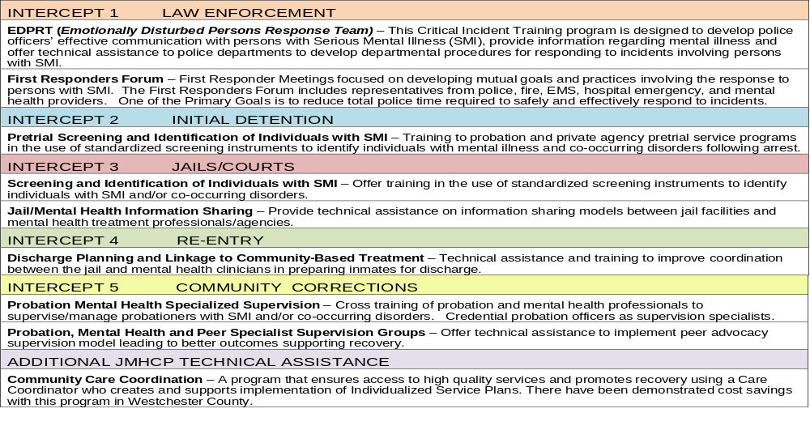
JMHCP Technical Assistance

Slide 11
JMHCP Expansion Grant
April 2015 submitted proposal to BJA for a JMHCP expansion grant for additional 5 counties
October earliest possible start date
If awarded, OPCA will:
  Add 5 more counties
  Increase technical assistance
  Offer new technical assistance in the areas of:
    Job readiness, employment and retention
    Risk, need and responsivity training for criminal justice and treatment providers

Slide 12

NEW YORK STATE HEALTH HOMES:
CARE MANAGEMENT FOR THE CRIMINAL JUSTICE INVOLVED POPULATION
Deirdre Astin, New York State Department of Health
Office of Health Insurance Programs

Slide 13

What is a Health Home?
Section 2703 of the Affordable Care Act (ACA) authorized an optional Medicaid State Plan benefit to establish Health Homes to coordinate care for people with Medicaid who have chronic conditions.
Health Homes provide comprehensive, integrated, person-centered care management and coordination to Medicaid enrollees with complex needs through a network of medical, behavioral health, and social service providers.

Slide 14
New York State Health Home Model
14
Health Homes must have connected under a single point of accountability all of the following:
      One or more hospital systems
      Multiple ambulatory care sites (physical and behavioral health)
      Community based organizations, including existing care management and housing providers
Single Point of Accountability (Designated Lead HH) is responsible for governance and operations, development of standardized policies and procedures for care management across its network of providers.

Slide 15
New York State Health Home Model
Managed Care Organizations (MCOs)
New York State Designated Lead Health Home
Administrative Services, Network Management, HIT Support/Data Exchange
Health Home Care Management Network Partners (includes former OMH TCM, and HIV/AIDS COBRA Providers)
Comprehensive Care Management
Care Coordination and Health Promotion
Comprehensive Transitional Care
Individual and Family Support
Referral to Community and Social Support Services
Use of Health Information Technology to Link Services (Electronic Care Management Records)
MAPP
RHIO
Access to Required Primary and Specialty Services
(Coordinated with MCO)
Physical Health, Behavioral Health, Substance Use Disorder Services, HIV/AIDS, Housing, Social Services and Supports

Slide 16
Health Home Vision
TODAY’S CARE
HEALTH HOME CARE
My patients are those who make appointments to see me
Our patients are those who
are registered in our health home
Patients’ chief complaints or
reasons for visit determines care
We systematically assess all
our patients’ health needs to plan care
Care is determined by today’s
problem and time available today
Care is determined by a proactive
plan to meet patient needs without visits
Care varies by scheduled time
and memory or skill of the doctor
Care is standardized according
to evidence-based guidelines
Patients are responsible for coordinating their own care
A prepared team of professionals coordinates all patients’ care
I know I deliver high quality care because I’m well trained
We measure our quality and
make rapid changes to improve it
Acute care is delivered in the next available appointment and walk-ins
Acute care is delivered by
open access and non-visit contacts
It’s up to the patient to
tell us what happened to them
We track tests & consultations,
and follow-up after ED & hospital
A multidisciplinary team works at
the top of our licenses to serve patients
Clinic operations center
on meeting the doctor’s needs
Notes:
IBM Confidential

Slide 17
Health Home Care Management Services
17
Health homes provide the following Health Home services in accordance with federal and State requirements:
      Comprehensive care management
      Care coordination and health promotion
      Comprehensive transitional care
      Patient and family supports
      Referral to Community and Social Support Services
      Use of Health Information Technology (HIT) to Link Services
Health Home care management is an opportunity to link CJ involved individuals to systems of health, behavioral health and community care and supports to reduce disparities and recidivism rates.

Slide 18
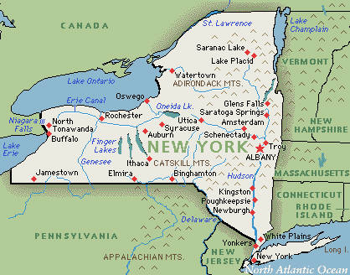
New York State Health Home Population
18
More than five million Medicaid members in New York State.
1.2 million individuals meet the Federal criteria for Health Homes.
Target enrollment for NYS is 829,000 (prioritizing for highest risk). Over 140,000 individuals engaged to date
There are 31 Health Homes serving all counties of the State (some Health Homes serve more than one county).

Slide 19
Who is Eligible to be Enrolled in a Health Home?
19
Persons enrolled in Medicaid with:
  At least two chronic conditions
  One qualifying chronic condition: (HIV/AIDS) or one serious mental illness
Chronic Conditions Include (but are not limited to):
  Mental Health condition
  Substance Use Disorder
  Asthma
  Diabetes
  Heart Disease
  BMI>25 (overweight or obese)
    Eligibility criteria to be expanded for children, to include trauma with risk for another condition
19

Slide 20
Criminal Justice:
Health and Behavioral Health Disparities
20
53% Women & 35% Men involved in the criminal justice system report a current medical issue. (National Health Care For The Homeless 2013)
60-80% of all individuals under supervision have a substance use related issue. (SAMHSA 2013)
17% of all individuals under supervision have been diagnosed with a serious mental illness, of this 17%, 75% have a co-occurring disorder. (CSG 2013)
64% of all those in jail have some form of mental illness. (OJP 2013)
17% are either HIV+ or living w/AIDS. (National Health Care For The Homeless 2013)
20
20

Slide 21
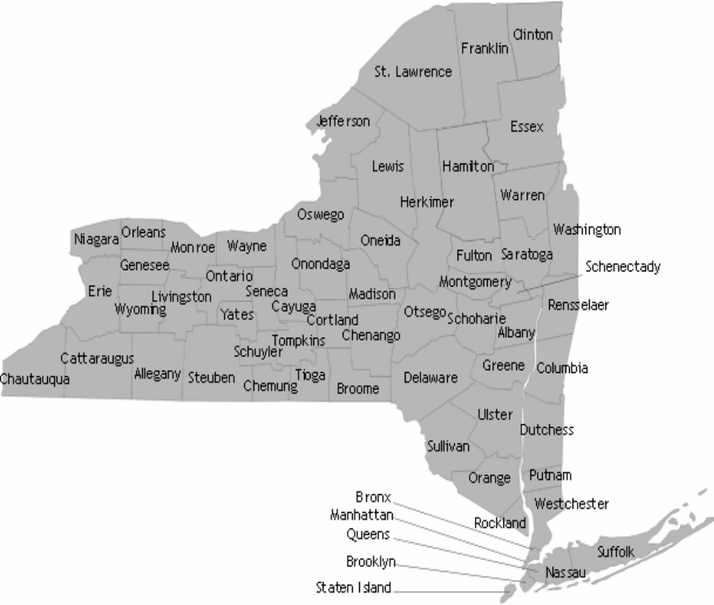
Health Homes and Criminal Justice Pilots
Pilot Site
HHUNY Finger Lakes, Huther Doyle
Project Partnership
HHUNY Western, Lakeshore/
Horizon
Bronx Lebanon
Bronx Accountable Healthcare Network
Coordinated Behavioral Care
Brooklyn Health Home
Community Healthcare Network

Slide 22
Common Themes to Date
22
Each site is working with criminal justice partners to identify and engage formerly incarcerated individuals:
Established partnerships with Correctional Facilities and Court Systems (Personnel) for early identification of potential candidates or current members incarcerated.
  E.g. – One site has partnered with NYC DOHMH/Correctional Health Services, and another with the County DA and Court.
Established data systems to track and monitor potential and current enrollees that are discharged from a facility, are admitted to a hospital, and/or have used the ER.
One way Care Managers establish a trusting relationship with the individual is through engagement prior to release.
  E.g. – One site has a Care Manager embedded within the jail
  Care Plans are developed with the enrollee that are centered on individuals’ needs and goals.
  Individual is motivated to take control of his/her care and wellness.
22
22
22

Slide 23
Challenges
23
Medicaid enrollment and eligibility
  Delays in Medicaid enrollment verification
  High percentage of clients without insurance
Data sharing and HIT connectivity
  Medicaid data is subject to strict federal and State protections
  Criminal justice agencies have not been allowed access for incarcerated Medicaid recipients
Lack of sufficient resources
Working with the State Prison System
  Mobility of incarcerated population
  Variability in release sites
23
23
23
23

Slide 24
Solutions: Data Sharing and Connectivity
24
Confidentiality Agreement (OCFS + DOH)
  For connecting NYSID numbers with Medicaid data systems to facilitate outreach and enrollment of CJ involved individuals
Medicaid Analytics Performance Portal (MAPP) development (OHIP)
  A web-based portal for greater data sharing and wide scale communication between DOCCS, DCJS, DOH/OHIP + Health Homes, MCO, CMAs, and CJ agencies
Interagency MOU crafting for sharing of Medicaid Confidential Data (MCD)
Working with the State Prison System for identification of linkages
  DOCCS has shared a de-identified cohort of 22,000 releases with OHIP to test and refine member-level data matching
24
24
24
24
24
24

Slide 25
Solutions: Resources
25
Delivery System Incentive Program (DSRIP)
  $8 billion in federal MRT savings to achieve comprehensive reform of the healthcare safety net system
  Safety net providers will be required to form Performing Provider Systems (PPS), conduct Community Health Assessments to identify needs in CJ population, and select projects based on those needs; incentive payments contingent on meeting goals.
Health Homes are an opportunity to address disparities in the care of the criminal justice involved population. Executive Budget includes $5 million in 2015-16 and 2016-17 to establish linkages between Health Homes and Criminal Justice system
25
25
25
25
25
25
25

Slide 26

Resources
  Visit the Health Home Website:
  https://www.health.ny.gov/health_care/medicaid/program/medicaid_health_homes/

Slide 27
Monroe County: Initiatives and CJ-HH Pilot
^{Robert Lebman, MA}
^{President & CEO Huther Doyle}
^{Rodney Corry, MA, LMHC}
Monroe County, Chief, Priority and Socio-Legal Services
^{Craig Johnson, LMHC, CASAC-G}
^{Supervisor,} Behavioral Health Programs, Monroe County
Monroe County Correctional Facility

Slide 28
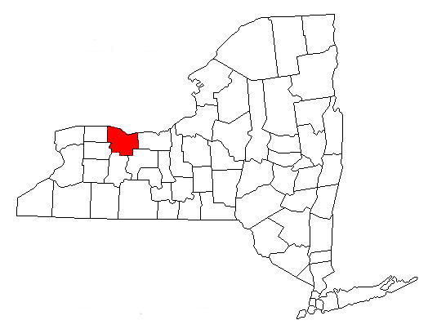
CJ–HH Pilot lessons Monroe County
^{Purpose}
• Brief overview of MH/CJ collaborative activities in Monroe County (pop. 750,000)
• Organized into regular activities and special projects
• Highlight opportunities for connections between various community initiatives

Slide 29
CJ–HH Pilot lessons Monroe County
^{Regular activities}
• Criminal Justice/Mental Health Committee
– MCSO; Jail; RPD; Courts; Probation; Parole; District Attorney; Public Defender; RFU; NAMI; Veterans Outreach; MCOMH
^{• Emergency Services Committee}
– CPEP & ED; Mobile Crisis; Detox; MCSO; Jail; RPD; 911;EMS; OPWDD; START; MCOMH
• Multi-Jurisdictional Crisis Intervention Task Force
– All police jurisdictions and two area colleges
• Forensic Committee at Rochester Psychiatric Center
^{– RFU, RPD, MCSO}

Slide 30
CJ–HH Pilot lessons Monroe County
^{Regular activities (continued)}
EDPRT Trainings for new police officers
  – Week long annual training for new classes
  – Info about mental health, mental hygiene law, other behavioral health topics
MCOMH on call process for clinical consultation to sheriff/police
  – Real time advisement as incidents occur – Evening and weekends
Transition Management in MH Court

Slide 31
CJ–HH Pilot lessons Monroe County
^{Special Projects}
^{• DCJS grant}
  ^{– Sequential mapping exercise}
  – Technical assistance re: probation peer groups
• MH/Jail Data matching project
  – automated process to match new jail admissions with mental health service utilization data to inform jail staff and current providers (implemented March 2015)
• Trauma Informed Practices consultation and training for all jail staff
  ^{– Scheduled for Fall 2015}

Slide 32
CJ–HH Pilot lessons Monroe County
^{Health Home Pilot to date}
• Care Manager assigned part-time to County Jail
• Works with facility staff to identify eligible inmates 3 months pre-release
• Does assessment and ascertains interest
• Identifies re-entry needs: housing, insurance, primary care, mental health/substance abuse, vocational/educational ....
• Develops interim plan with inmate

Slide 33
CJ–HH Pilot lessons Monroe County
^{Pilot continued}
• Post release: assists in opening/reactivating Medicaid
• Enrolls released inmate in Health Home
• Implements Care Plan and provides necessary support

Slide 34
CJ–HH Pilot lessons Monroe County
^{Pilot evolving}
• Discussions underway to implement Vivitrol induction pre-release for appropriate inmates
• Presentations have been made to Assistant DAs: Health Home services; Vivitrol
• Individuals who may be eligible for Health Home and who have a drug use history will be identified at arraignment
• Health Home Care Manager will be assigned to Drug Court, DWI Court and Mental Health Court

Slide 35
CJ–HH Pilot lessons Monroe County
^{Pilot} ^{Evolving (continued)}
Comprehensive Assessment will be completed and Care Plan developed
Care Manager will make regular reports to the Court and/or Probation
District Attorney will arrange presentations to Bar Association and Judges to expand model across criminal justice system
Re-entry Task Force will place Care Manager in area state facility and replicate Monroe County Jail model

Slide 36
CJ –HH Pilot lessons Monroe County
^{Future Work}
• Health Home lead agency, Correctional staff and Monroe County Socio-Legal will begin meeting to identify areas where information should/can be shared and services coordinated
• The potential for collaborating to track and measure outcomes will be explored

Slide 37
Schenectady County Collaboration:
Mental Health, Criminal Justice and Health Home
Darin Samaha, LCSW-R
Director of Community Services
Schenectady County

Slide 38
Schenectady County
Overview of MH/CJ collaborations in Schenectady County (pop. 155,000)
Schenectady County JMHCP Phase 1(January 2014)
Changing Environment - Changing strategies (building the plane as it’s flying)

Slide 39
Schenectady County
Collaboration pre JMHCP
Mental Health Courts (City and County)
Trauma Trainings
SPOA
County Re-Entry Taskforce
Probation, Mental Health and Peer Specialist Supervision Groups
  “Tweaking” the model
Specialized Mental Health Probation Officers
Executive Leadership Committee

Slide 40
Post JMHCP and Jail MH Grant
Sequential intercept mapping (SIM)
Veterans-Track
Mental Health & Substance Abuse training for Public Defenders and District Attorney’s Office
Mental Health Jail Grant
Emotionally Disturbed Persons Response Team (EDPRT)

Slide 41
Continued
SAMHSA GAINS Center – Trauma Informed Law Enforcement Training
  “11th County”
Starting Regional Adult Mobile Crisis Team
  Target Population – Jail/Prison Discharge

Slide 42
Jail Mental Health Grant
Inmate Services Coordinator
Peer Mentors Pre/Post Release
Probation/Peer Transition Group
Health Home / Forensics Linkage

Slide 43
History of Strong Cross Systems Collaborations
Eventful 2014
Crises and Community Response
Suicide contagion
Hurricane Irene and Tropical Storm Lee
Fires - 50 people homeless
Nationally Reported Suicide

Slide 44
Schenectady
Care Coordination and Health Home Linkages
Leadership Changes
Addressing System Gaps
Schenectady Problem Solving Model Based on SIM

Slide 45
Schenectady
Forensic Workgroup - June 16, 2015
All stakeholders involved with jail releases
Meeting to address gaps and overlaps in the system
Establish protocols to better coordinate resources and services
E.g. - Define problems such as: reactivation of Medicaid as soon as possible; provide for adequate medication until intake assessment in the community; create a release checklist; develop list of other issues or problems to resolve and subgroups as needed
Next steps - formalize group into Behavioral Health- Criminal Justice workgroup

Slide 46
JMHCP
Questions?

Slide 47
Handouts
Mapping the Criminal Justice System to Connect Justice-Involved Individuals with Treatment and Health Care under the Affordable Care Act, Bureau of Justice, National Institute of Corrections, Lore Joplin, June 2014
The Affordable Care Act and Criminal Justice: Intersections and Implications, Andrea A. Bainbridge, Bureau of Justice Assistance, U.S. Department of Justice, July 2012
The Stepping Up Initiative: A National Initiative to Reduce the number of People with Mental Illnesses in Jails, Council of State Governments (CSG) and the National Association of Counties (NaCO)
The Affordable Care Act and County Jails: A Practical Guide to Strategies and Steps for Implementation, Denver Sheriff’s Department, Sheriff Gary Wilson, December 2013
Health Coverage and County Jails: Suspension vs Termination, National Association of Counties (NaCO), December, 2014
Ten Ways Corrections Systems Can Help Link Returning Offenders to Health Insurance, HealthCare.gov
Health Homes Survey of the County Re-Entry Taskforces, DCJS/OPCA June 2015

Slide 48
Resources
New York State Department of Health Health Home website
http://www.health.ny.gov/health_care/medicaid/program/medicaid_health_homes/
Federal ACA Website
https://www.healthcare.gov/incarcerated-people/
Pennsylvania response to ACA - website
http://www.pacenterofexcellence.pitt.edu/ACA.html
Website for state information on criminal justice and health care
https://www.statereforum.org/node/9737
Study of health care and public safety
http://www.arnoldfoundation.org/researchers-study-affordable-care-act’s-impact-public-safety
Stepping Up: A National Initiative to Reduce the Number of People with Mental Illnesses in Jails
https://stepuptogether.org

